Slide 1


Slide 2


Slide 3


Slide 4
Sorry!
The app that you were running crashed.
Close to return to Windos.
An error report has been sent to Micr0$0ft.

Slide 5
Access denied!
You have no permission to access this!
Windos XP is doing this for the sake of Windos XP.
Do you want to destroy this OS?
Wait, what?
There is no way I will let you destroy Windos XP!

Slide 6
EXE file error
This EXE file cannot be opened.
It does not have a valid GUI.
Please close the widow to return to the desktop.

Slide 8
CMD:
\User\data\CMD\cmd.exe>

Slide 9
CMD PROG:
\User\data\CMD\cmd.exe>

Slide 10
Explorer

Slide 11
EDGE site***
Home***about***help***quit

Slide 13




















All legacy icons

Slide 14



































































All icons

Slide 15





All icons from the essentials pack***Made by Smashicons on flaticon.com

Slide 16
All icons from the interface pack***Made by Chanut on flaticon.com

Slide 17
All icons from the adobe logos pack***Made by Chanut on flaticon.com

Slide 18

All icons from Power User***Made by Power User

Slide 19


Slide 20
What’s new in this version:
It’s the app update!
added more apps
Updated access denied screen
Added power menu so late in!
Added scandisk utility
Windos XP beta 2
This version of Windos is not genuine
Unstable OS build
start

Slide 21
Administrator***standard user***Users
Welcome to Windos XP!
Explorer
Control Panel
All Apps
Run…
Web browser
EDGE 1
Email client
none
Windos Security Essentials
Power. ..
start

Slide 22

Power menu
Shut down
reboot
scandisk
Real mode DOS

Slide 23
All apps
Explorer
EDGE
WSE v1.00
SSH client
Resource monitor
Scandisk

Slide 24
EDGE 1
Registered to:
Username
Company
V1. 02

Slide 25
EDGE v1.02***stable browser***unstable OS build
Welcome to the Internet, Administrator!
Click on a link to go to the corresponding website:
Google
Bing
Ask Jeeves
Windos official
Version Plan XP
EDGE insider
Google Krom
Welcome to EDGE, IE’s replacement. Click on an underlined piece of text to go to that website!
Home***about***help***quit

Slide 26
Windos help utility
V1.01
For Windos XP

Slide 27
Help error
Help cannot find windos.hlp in \Windos\system\
Please update and try again.

Slide 28
Explorer
\

Slide 29
Explorer
\
User
ALLAPPS
Windos

Slide 30
Explorer
\Windos
system32
Windos.exe
icon

Slide 31
Explorer
\Windos\icons
current.dll
ess1.dll
Legacy.dll
interface.dll
adobe.dll

Slide 32
EDGE site***Windos XP Official Site
Become an insider and get a free copy when it comes out!
>get Windos XP alpha <blocked by site>
>discover Windos XP <invalid URL>
>features <invalid URL>
>security standards <invalid URL>
>become an Insider <invalid URL>
>Windos 2000 <invalid URL>
>Windos Vista <invalid URL>
Discover Windos XP, the next version of Windos!
EDGE tells you if a link is invalid so you can save time!
start
Windos XP alpha
Home***about***help***quit

Slide 33
EDGE site***XP version plan
Version plan:
Beta 1 is the Internet Update
beta 2 App Update
Beta 3 Security update
Beta 4- help update
Beta 5- final beta update
V1. 00 launch update
V1. 01 new tech
V1. 02 new tech + features
V1. 03 new features
SP1
SP2
SP3
V1.04 final update
V1. 05 discontinuation update
Home***about***help***quit

Slide 34
Windos Security Essentials v1.00
Security essentials for Windos 2000 SP2 and XP V1. 00
Antivirus ON
Ransom Protect
Firewall
VPN
Internet Blocker ON

Slide 35
Scanning for malware…

Slide 36
Results:
NaN

Slide 37
Internet Blocker 1.0
Internet Blocker is the replacement for the age old Web Protection standard.
This blocker uses advanced tech to detect if a suite is a scam, virus, or PUP and does NOT let you through.
It is enabled by default and even blocks fake ads!

Slide 38
System summary:
beta OS installed
Internet Blocker 1.0 ON
Antivirus ON
Firewall OFF
VPN OFF
Ransom Protect OFF
Legacy BIOS 2 ON
WP3 ON

Slide 39
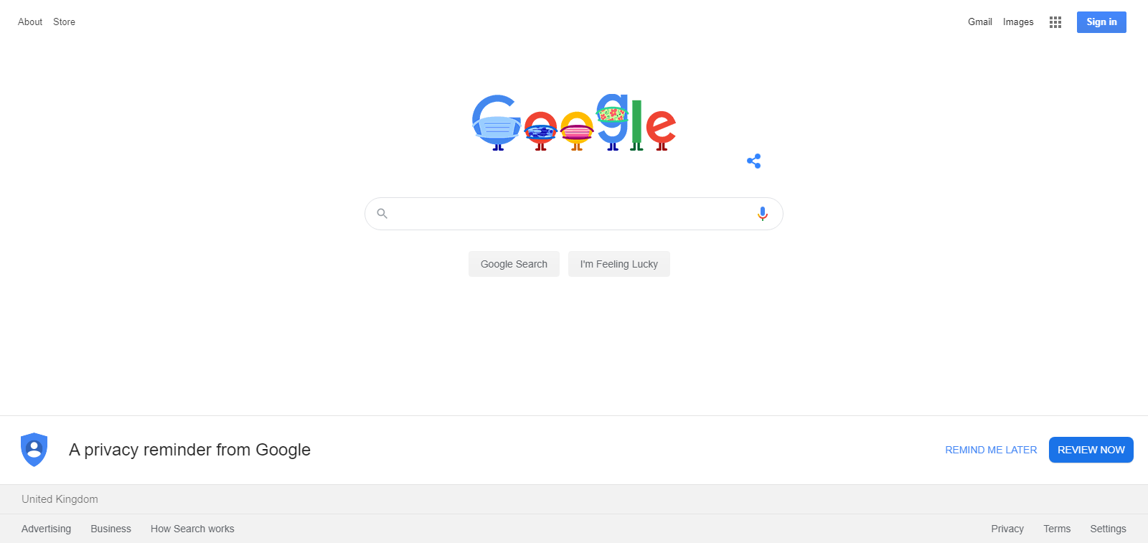
EDGE site***Google as of 5/8/2020
Home***about***help***quit

Slide 40

EDGE site***Bing as of 5/8/2020
Home***about***help***quit

Slide 41

EDGE site***Ask Jeeves
Home***about***help***quit

Slide 42
Run. ..
Winver
OK
Cancel
Help

Slide 43
About Windos
Micr0$0ft Windos XP
Beta –
2020 Micr0$0ft c0rp
Registered to:
Administrator
Company

Slide 44
EDGE site***EDGE insider
Download EDGE beta and test features out!
>Data-insert
>browser=kromv42
>AdBlock=false
>OS=win2k v1.00
>region=UK
>date=5/8/2020
>apply-all
>close
>keep-settings-1
>login admin pass
LOGIN INCORRECT
>exit
>hack edgeinsider.com login
Enter username
>admin
Searching. ..
Found user admin
Password=password
>login admin password
Logged in
>plugin-AdBlock=on
AdBlock is on
>exit
>set <site> EDGE Insider
>exit
>quit
Info:
Krom 42
UK
Username: Admin
download
Home***about***help***quit

Slide 45
EDGE Insider preview
V1. 00
Registered to insider:
Admin
Password

Slide 46
EDGE insider v1.02***stable OS****unstable browser***username= admin
Select a web page to view:
Google
Bing
Ask Jeeves
Windos official
Version Plan XP
EDGE insider is for testing purposes only!
Home***about***CMD***help***CMD v2***Hacker***exit

Slide 47
CMD v0.50
\User\data\CMD\cmd.exe>
Website Hacker
Winver
SSH

Slide 48
[ADMIN] CMD: Web Hacker v1.00***home
\Windos\system32\.hacks\web-hack\webhack.bat>
Google
Bing
Google Krom [console fitted in]
EDGE Insider [console fitted in]
Windos Official Site

Slide 49
CMD: hack google.com
>google.com
Connected to host google.com
>login admin password
Username non existent
>net user create admin
1.Admin
2.User
3.Premium user
>>1
Adding. ..
Error access denied
>hack login type=admin
Searching. ..found 223 admins.
>phish login type=admin no=1
U: Akinator
P: iamtoohard2beat
>login Akinator iamtoohard2beat
Logged in as Akinator.
>retrieve server data #private #project-x #top-secret #ceo
Retrieving data…
Save to?
>>\hacks\google
Saved.
>Sell \hacks\google
Sell to?
>haxorz.com
Searching. ..login needed
>disconnect
Enter URL!
>haxorz.com
Connected to host haxorz.com
>login Kevin-Mitnick AltaVista
Login success!
>sell \hacks\Google
Sell for?
$100,000
Put on sale.
>disconnect
>quit

Slide 50
CMD: bing.com
>bing.com
Connected
>login user pass
Login unavailable
>session 2
>microsoft.com
Connected
>session 1
>login user pass @session2
User invalid
>session 3
>haxorz.com
Connected
>search [Microsoft admin login]
Found Microsoft Admin Login 2020. product no. 1234567
>buy 1234567
Price is $100. accept?
>>yes
Bought. Username Adminz password Killer
>session 1
>login Adminz Killer
Logged in.
>phish #secret
Searching. ..
Save 25Tb to?
>\hacks\Bing
Saving. ..
Error. Firewall stopped transfer
>admin command
>>>firewall status
25 firewalls active
>>>disable firewall 25
22 disabled. 4 remain
>>>exit
>attack firewall 4
Attack complete
>reattempt-dl
Downloading. ..
>session 3
>sell \hacks\Bing $100,000
Sold.
>exit

Slide 51

EDGE site***Google Krom
>data set
On
>browser=edge v1.00
>region=UK
>AdBlock=false
Apply=all
>close
Off.
>hack now
Hacking. .. Stored on\hacks\Krom
>haxorz.com login auto
OK
>sell \hacks\Krom $250,000
Sold.
>stop console
-------Console stopped------
EDGE sucks,
Get Krom!
Download button below:
Get Krom For Free!
Home***about***help***quit

Slide 52
SSH
>
EDGE
Krom locked
EDGE Insider locked
Winver
WSE

Slide 53
CMD PROG: scandisk
\User\data\CMD\cmd.exe>scandisk
Scandisk v1.00
Scandisk is ready to begin scanning the system!
This will reboot Windos into Scandisk mode.
Please save all data before proceeding.
reboot
cancel

Slide 54
It is now safe to turn off the PC.
Close to reboot.

Slide 55
Starting SCANDISK mode…

Slide 56
SCANDISK
Ready to scan Drive C
>start scan
>exit
Drive C
MTFS v2
120Gb free of 128Gb

Slide 57
SCANDISK
Scanning \
>scanning file allocation tables…
Drive C
MTFS v2
120Gb free of 128Gb
>

Slide 58
SCANDISK
Scanning \
>scanning file allocation tables: found 0 errors
>scanning system files
Drive C
MTFS v2
120Gb free of 128Gb
>

Slide 59
SCANDISK
Scanning \
>scanning file allocation tables: found 0 errors
>scanning system files: found 123 errors
>fixing errors…
Drive C
MTFS v2
120Gb free of 128Gb
>

Slide 60
SCANDISK
Scanning \
>scanning file allocation tables: found 0 errors
>scanning system files: fixed 123 errors
>scanning directory tree…
Drive C
MTFS v2
120Gb free of 128Gb
>

Slide 61
SCANDISK
Scanning \
>scanning file allocation tables: found 0 errors
>scanning system files: fixed 123 errors
>scanning directory tree…no errors
>scanning disk surface…
Drive C
MTFS v2
120Gb free of 128Gb
>

Slide 62
SCANDISK
Scanning \
>scanning file allocation tables: found 0 errors
>scanning system files: fixed 123 errors
>scanning directory tree…no errors
>scanning disk surface…12 errors fixed
>scanning MTFS tables…
Drive C
MTFS v2
120Gb free of 128Gb
>

Slide 63
SCANDISK
Scanning \
>scanning file allocation tables: found 0 errors
>scanning system files: fixed 123 errors
>scanning directory tree…no errors
>scanning disk surface…12 errors fixed
>scanning MTFS tables…found 1234567890 errors.
>fixing errors…
Drive C
MTFS v2
120Gb free of 128Gb
>

Slide 64
SCANDISK
Scanning \
>scanning file allocation tables: found 0 errors
>scanning system files: fixed 123 errors
>scanning directory tree…no errors
>scanning disk surface…12 errors fixed
>scanning MTFS tables…fixed 1234567890 errors.
>finished scan.
Total errors: 1,234,568,025. 0 errors left.
>exit
Drive C
MTFS v2
120Gb free of 128Gb

Slide 65
Starting DOS mode…
DOS mode is not supported in MTFS partitions!
>exit
>scandisk
>repair mode

Slide 66
Welcome to Windos XP repair!
Please wait as it boots up…

Slide 67
CMD PROG: setup
\Windos\system32\>repair.exe
repair
Welcome to repair!
Enter your key or press skip.
----- ----- ----- ----- -----
skip

Slide 68
CMD PROG: setup
\Windos\system32\>repair.exe
repair
Press install to reinstall Windos XP!
reinstall

Slide 69
Installing Windos XP…
This will take a while

Slide 70
Resource monitor
CPU usage:--%
Disk usage: 50% of 128Gb
RAM usage: 100% of 16Gb
VRAM usage: 12% of 4Gb
Video memory: 32Mb
MTFS usage: 1Gb
FAT usage: 40Gb
Windos usage: 15Gb

